Slide 1
ENGT 3510
Chapter 5
Joint Probability Distributions

Slide 2

Introduction
We discussed different probability distributions for a single random variable.
In many cases, we work with two or more random variables simultaneously.
Example:
X: the length of one dimension of an injection-molded part
Y: the length of another dimension
Targeted range of X and Y:
$$2.95<X<3.05$$
$$7.60<Y<7.80$$
The part quality is high if both X and Y are within their targeted ranges:
$$P\left(2.95<X<3.05 and 7.60<Y<7.80 \right)$$
The probability distribution that defines the simultaneous behavior of two or more random variable is called a joint probability distribution.

Slide 3
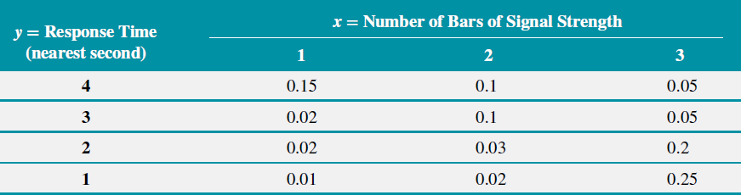

Example
The response time is the speed of page downloads and it is critical for a mobile Web site. As the response time increases, customers become more frustrated and potentially abandon the site for a competitive one.
Let $X=$ the number of bars of service and $Y=$response time (to the nearest second)
We define the range of the random variables $(X, Y)$to be the set of points $(x, y)$in two-dimensional space for which the probability that $X = x$and $Y = y$is positive.

Slide 4

Example
X: Discrete or continuous?
Y: Discrete or continuous?
$$P\left(X=2\right)=?$$
$$P\left(Y=2\right)=?$$
$$P\left(X=1 and Y=3\right)=?$$

Slide 5
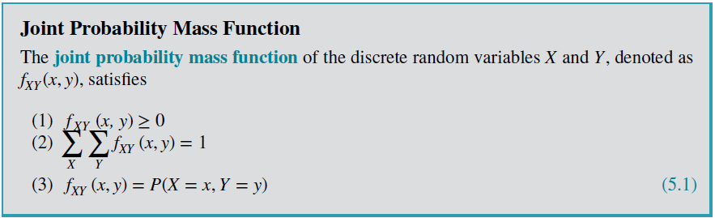

Joint Probability Mass Function
If $X$ and $Y$ are discrete random variables, the joint probability distribution of $X$and $Y$is a description of the set of points $(x, y)$in the range of $(X, Y)$ along with the probability of each point.
$P(X=x and Y=y)$ is usually written as $P(X=x, Y=y)$
The joint probability distribution of two random variables is sometimes referred to as the bivariate probability distribution or bivariate distribution of the random variables

Slide 6
Marginal Probability Distributions
If more than one random variable is defined in a random experiment, the individual probability distribution of a random variable is referred to as its marginal probability distribution.
To determine P(X = x), we sum P(X = x, Y = y) over all points in the range of(X, Y) for which X = x.

Slide 7

Marginal Probability Distributions
Example: Determine marginal probability distribution of X and Y.
Solution
$$f_{X}\left(3\right)=P\left(X=3\right)=P\left(X=3,Y=1\right)+P\left(X=3,Y=2\right)+P\left(X=3,Y=3\right)+P\left(X=3,Y=4\right)$$
$$=0.05+0.05+0.20+0.25=0.55$$
$$f_{Y}\left(2\right)=?$$

Slide 8
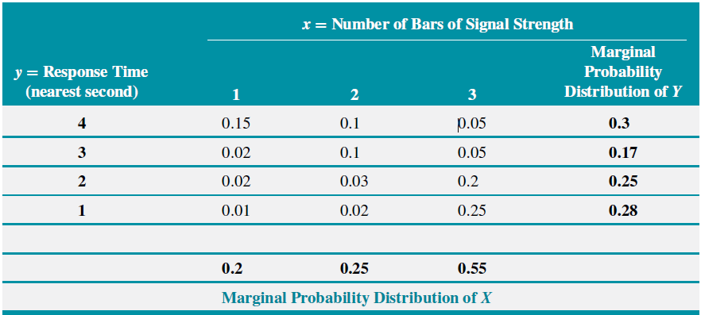
Marginal Probability Distributions
Solution

Slide 9

Marginal Probability Distributions
$$E\left(X\right)=\sum_{all x}{xf_{X}(x)}$$
$$E\left(Y\right)=\sum_{all y}{yf_{Y}(y)}$$
$$V\left(X\right)=\sum_{all x}{{\left(x−E\left(x\right)\right)}^{2}f_{X}\left(x\right)}=\sum_{all x}{x^{2}f_{X}\left(x\right)}−{\left[E(X)\right]}^{2}$$
$$V\left(Y\right)=\sum_{all y}{{\left(y−E\left(y\right)\right)}^{2}f_{Y}(y)}=\sum_{all x}{y^{2}f_{Y}\left(y\right)}−{\left[E(Y)\right]}^{2}$$

Slide 10
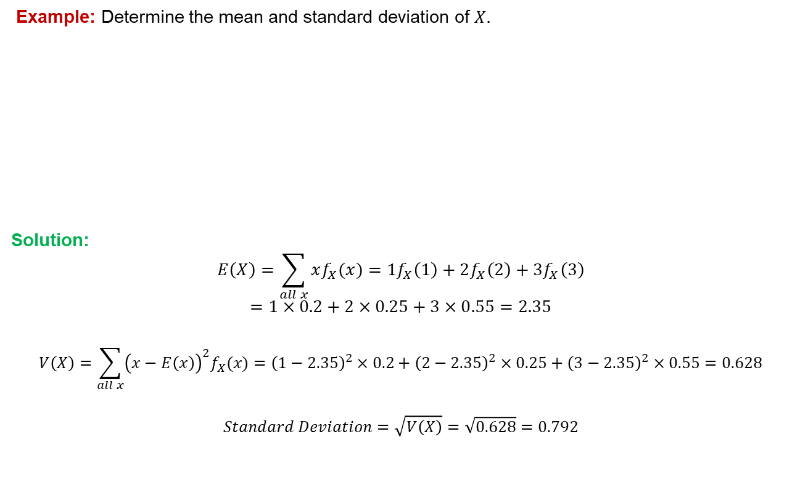
Marginal Probability Distributions
Example: Determine the mean and standard deviation of $X.$
Solution:
$$E\left(X\right)=\sum_{all x}{xf_{X}(x)}=1f_{X}\left(1\right)+2f_{X}\left(2\right)+3f_{X}\left(3\right)$$
$$=1×0.2+2×0.25+3×0.55=2.35$$
$$V\left(X\right)=\sum_{all x}{{\left(x−E\left(x\right)\right)}^{2}f_{X}(x)}={\left(1−2.35\right)}^{2}×0.2+{\left(2−2.35\right)}^{2}×0.25+{\left(3−2.35\right)}^{2}×0.55=0.628$$
$$Standard Deviation=\sqrt{V\left(X\right)}=\sqrt{0.628}=0.792$$

Slide 11

Conditional Probability Distributions
Given continuous random variables $X$and $Y$ with joint probability density function $f_{XY}(x, y)$, the conditional probability of Y give X is
$$f_{Y∣x}\left(y\right)=P(Y=y∣X=x)=\frac{f_{XY}\left(x,y\right)}{f_{X}\left(x\right)}$$
If X and Y are independent,
$$f_{Y∣x}\left(y\right)=\frac{f_{XY}\left(x,y\right)}{f_{X}\left(x\right)}=\frac{f_{X}\left(x\right)f_{Y}(y)}{f_{X}\left(x\right)}=f_{Y}(y)$$

Slide 12
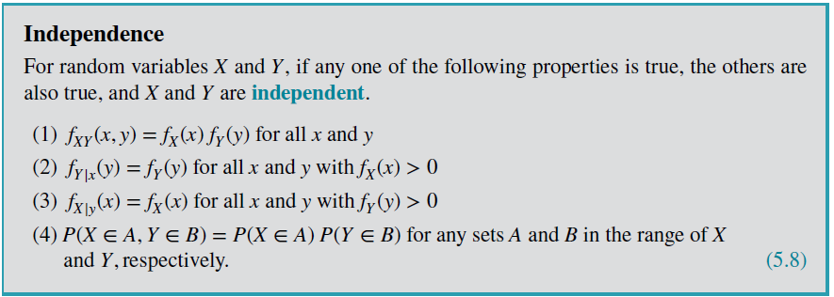
Independence

Slide 13

Conditional Probability Distributions
Example: Determine
$P(Y=1|X=3)$
$P(Y=2|X=3)$

Slide 14

Conditional Probability Distributions
Solution
a)
$$P\left(Y=1 | X=3\right)=\frac{P(Y=1,X=3)}{P(X=3)}=\frac{0.25}{0.55}=0.454$$
b)
$$P\left(Y=2 | X=3\right)=\frac{P(Y=2,X=3)}{P(X=3)}=\frac{0.20}{0.55}=0.364$$

Slide 15
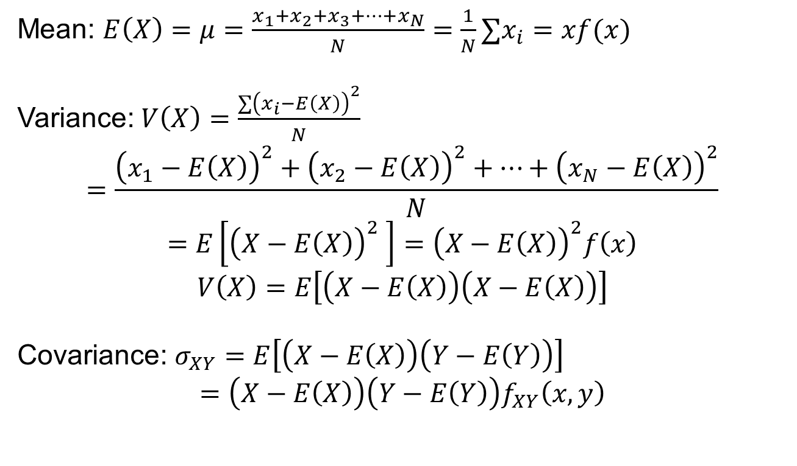
Mean, Variance, and Covariance
Mean: $E\left(X\right)=μ=\frac{x_{1}+x_{2}+x_{3}+…+x_{N}}{N}=\frac{1}{N}∑x_{i}=xf(x)$
Variance: $V\left(X\right)=\frac{∑{\left(x_{i}−E\left(X\right)\right)}^{2}}{N}$
$$=\frac{{\left(x_{1}−E\left(X\right)\right)}^{2}+{\left(x_{2}−E\left(X\right)\right)}^{2}+…+{\left(x_{N}−E\left(X\right)\right)}^{2}}{N}$$
$$=E\left[{\left(X−E\left(X\right)\right)}^{2} \right]={\left(X−E\left(X\right)\right)}^{2}f\left(x\right)$$
$$V\left(X\right)=E\left[\left(X−E\left(X\right)\right)\left(X−E\left(X\right)\right)\right]$$
Covariance: $σ_{XY}=E\left[\left(X−E\left(X\right)\right)\left(Y−E\left(Y\right)\right)\right]$
$$=\left(X−E\left(X\right)\right)\left(Y−E\left(Y\right)\right)f_{XY}\left(x,y\right)$$

Slide 16
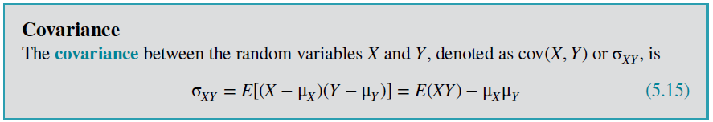
Covariance and Correlation
A common measure of the relationship between two random variables is the covariance.
How two or more random variable vary together?
How to measure the relationship between the variables?

Slide 17
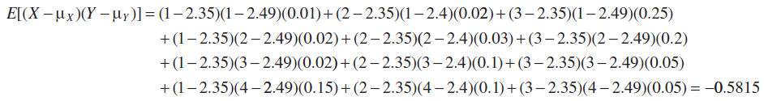
Covariance and Correlation
Example: Determine covariance between X and Y.
Solution:
Variance is always positive or zero, while covariance can be positive, negative, or zero. Why?

Slide 18
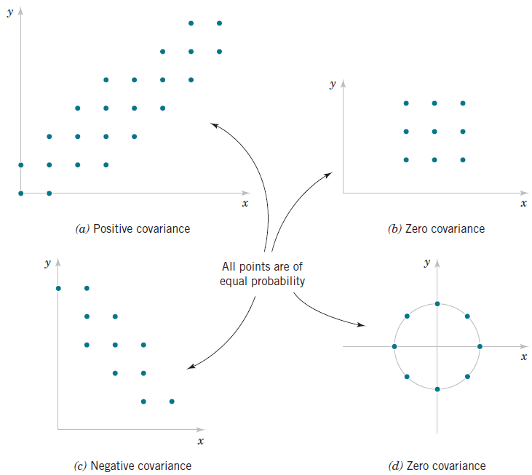
Covariance
Covariance is a measure of linear relationship between the random variables.
If the relationship between the random variables is nonlinear, the covariance might not be sensitive to the relationship.

Slide 19
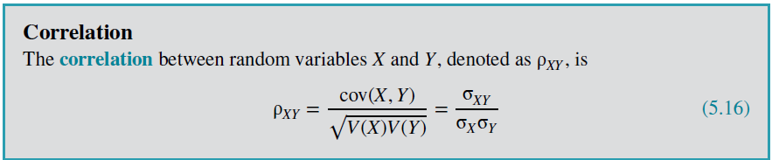
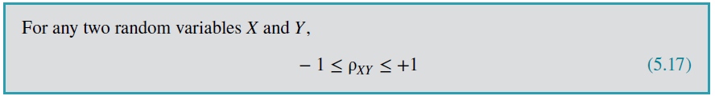
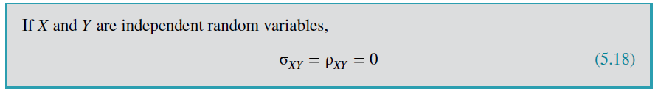
Correlation
Covariance is another measure of the relationship between two random variables
It is easier to interpret than the covariance.

Slide 20
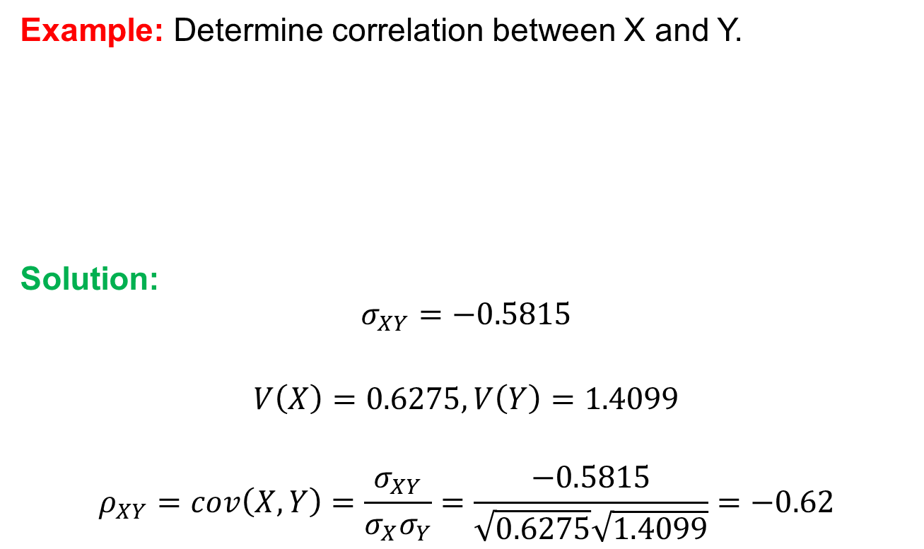
Correlation
Example: Determine correlation between X and Y.
Solution:
$$σ_{XY}=−0.5815$$
$$V\left(X\right)=0.6275, V\left(Y\right)=1.4099$$
$$ρ_{XY}=cov\left(X,Y\right)=\frac{σ_{XY}}{σ_{X}σ_{Y}}=\frac{−0.5815}{\sqrt{0.6275}\sqrt{1.4099}}=−0.62$$

Slide 21
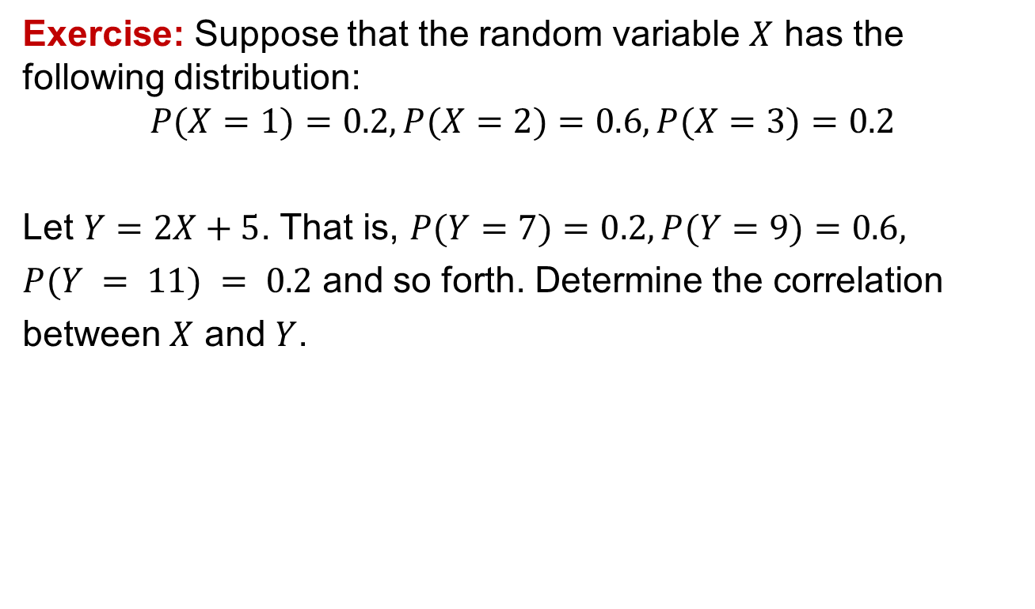
Correlation
Exercise: Suppose that the random variable $X$ has the following distribution:
$$P(X=1)=0.2, P(X=2)=0.6, P(X=3)=0.2$$
Let $Y=2X+5$. That is, $P(Y=7)=0.2, P(Y=9)=0.6,$
$P(Y = 11) = 0.2$ and so forth. Determine the correlation
between $X$ and $Y$.

Slide 22
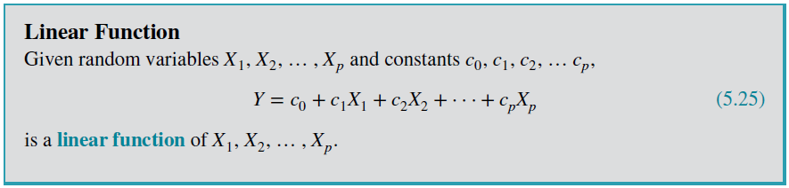

Linear Functions of Random Variables
A random variable is sometimes defined as a function of one or more random variables.
A linear relationship
$$Y=X_{1}+3X_{2}+5$$

Slide 23
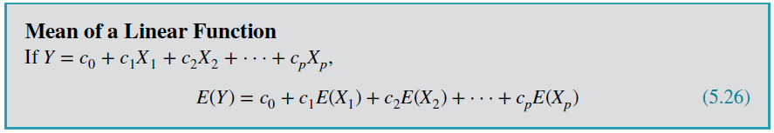
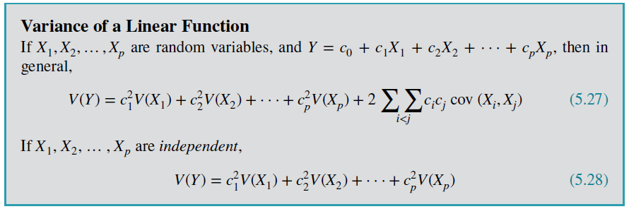

Linear Functions of Random Variables
$$Y=X_{1}+3X_{2}+5$$
$$E\left(Y\right)=E\left(X_{1}\right)+3E\left(X_{2}\right)+5$$
$$V\left(Y\right)=V\left(X_{1}\right)+3^{2}V(X_{2})$$

Slide 24
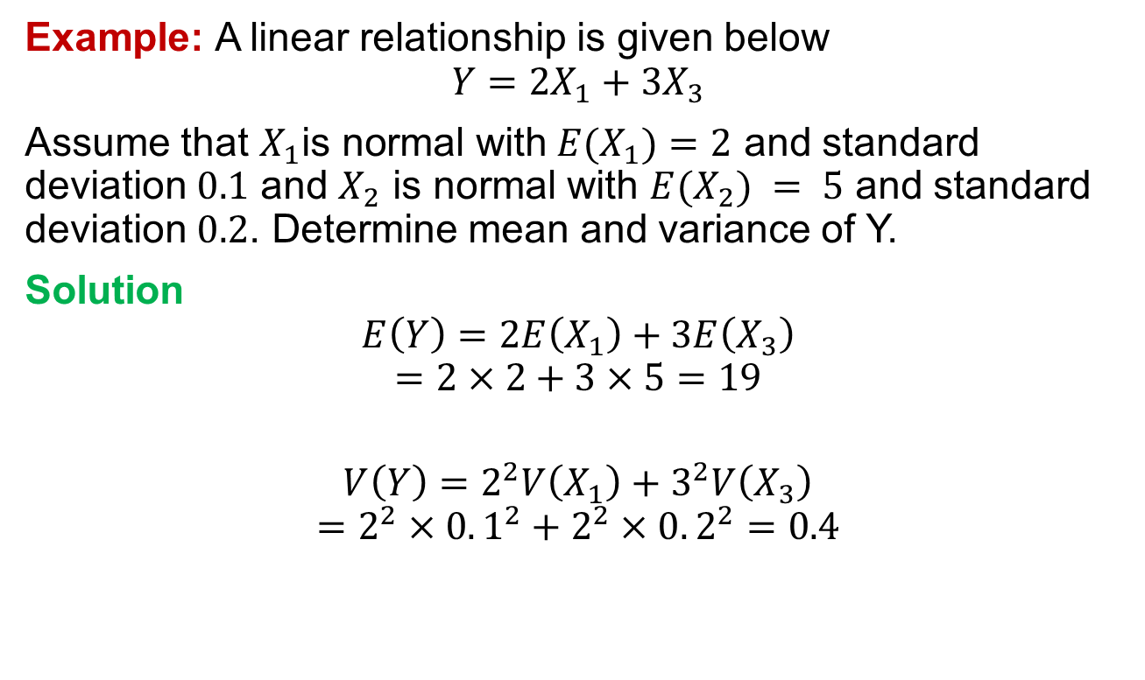
Linear Functions of Random Variables
Example: A linear relationship is given below
$$Y=2X_{1}+3X_{3}$$
Assume that $X_{1}\text{is} \text{normal} \text{with} E(X_{1})=2$ and standard deviation $0.1$ and $X_{2}$ is normal with $E(X_{2}) = 5$ and standard deviation $0.2$. Determine mean and variance of Y.
Solution
$$E\left(Y\right)=2E\left(X_{1}\right)+3E\left(X_{3}\right)$$
$$=2×2+3×5=19$$
$$V\left(Y\right)=2^{2}V\left(X_{1}\right)+3^{2}V\left(X_{3}\right)$$
$$=2^{2}×0.1^{2}+2^{2}×0.2^{2}=0.4$$

